Slide 1

1
INTRODUCTION TO WEB DEVELOPMENT
Code: COMP07009
Week 2
Reference: http://www.w3schools.com/html

Slide 2
What is HTML?
2
Language for describing web pages
Stands for Hyper Text Markup Language
Consists of a set of markup tags
Tags describe the document content
HTML documents contain HTML tags and text
HTML documents are also called web pages
HTML can be created using an HTML editor such as:
Notepad++, HTML-Kit
Adobe Dreamweaver
In this module, open source (ie. free) software will be used in the labs

Slide 3
HTML Elements / Tags
3
An HTML element is everything from the start tag to the end tag
Tags are keywords (tag names) surrounded by angled brackets like <html>
HTML Elements start with a start (opening) tag
HTML Elements end with an end (closing) tag
Normally come in pairs like <head> and </head>
End tag has a forward slash before the tag name
HTML elements with no content are empty elements
<br> tag which defines a line break is an empty element with no closing tag
Adding a slash inside the start tag is the proper way of closing
empty elements
<p>Break<br />lines<br />in a<br />paragraph</p>

Slide 4

What is HTML5?
4
HTML5 is the new standard for HTML
Previous versions
HTML 3.2
HTML 4.01
XHTML 1.0
HTML5 is the current formal web standard
HTML5 is supported by the major browsers

Slide 5
How did HTML5 get started?
5
HTML5 is a cooperation between the World Wide Web Consortium (W3C) and the Web Hypertext Application Technology Working Group (WHATWG).
WHATWG was working with web forms and applications, and W3C was working with XHTML 2.0. In 2006, they decided to cooperate and create a new version of HTML.

Slide 6
Rules for HTML5
6
New features should be based on HTML, CSS, DOM, and JavaScript
Reduce the need for external plugins (like Flash)
Better error handling
More markup to replace scripting
HTML5 should be device independent
The development process should be visible to the public

Slide 7
New Features
7
The <canvas> element for 2D drawing
The <video> and <audio> elements for media playback
Support for local storage
New content-specific elements, like <article>, <footer>,
<header>, <nav>, <section>
New form controls, like calendar, date, time, email, url, search

Slide 8
New Elements
8
The internet has changed a lot since HTML 4.01 became a standard in 1999.
Today, some elements in HTML 4.01 are obsolete, never used, or not used the way they were intended to. These elements are removed or re-written in HTML5.
To better handle today's internet use, HTML5 includes new elements for better structure, better form handling, drawing, and for media content.

Slide 9
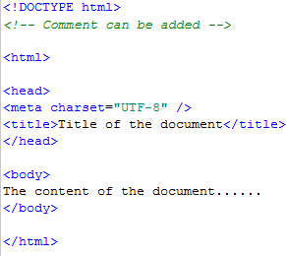
Getting started
9
Type some basic code into an HTML editor (some editors may have autocomplete feature)
eg

Slide 10
Getting started
10
Save the file with .html extension
View the file locally in a browser
The browser does not display the HTML tags, but uses the tags to interpret the content of the page
Comments are inserted into the source code to explain the code which useful when editing the code at a later date
Comments are ignored by the browser

Slide 11
Interpreting the code
11
DOCTYPE declaration defines the document type as HTML5
This is important for validation
Text between <html> and </html> describes the web page
The text between <body> and </body> is the visible page content
The <head> tag is a container for all the head
elements.
The <head> tag must include a title for the document, and can include scripts, styles, meta information and more.

Slide 12
Interpreting the code
12
The <title> tag defines the title of the document
Displays the title in the browser window
Provides a title for the page when it is added to favourites
Displays a title for the page in search-engine results
Metadata is data (information) about data.
It will not be displayed on the page
Charset specifies the character encoding for the HTML document as UTF-8

Slide 13
Structure
13
A web browser will ignore CARRIAGE RETURNS typed into an editor.
Therefore you need to tell the browser how a web page is split up
Eg headers, paragraphs, lists
HTML5 has new markup elements for better structure such as aside, header, footer
These will be looked at later

Slide 14
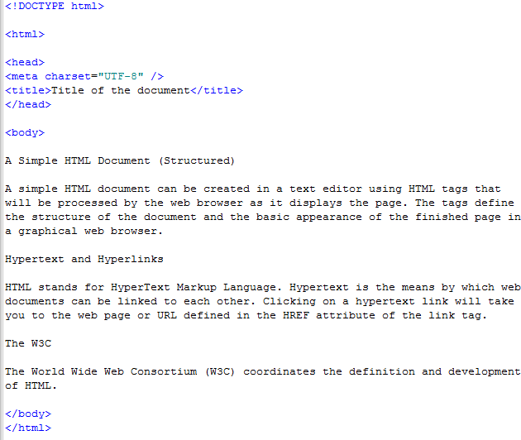
Block structure
14

Slide 15
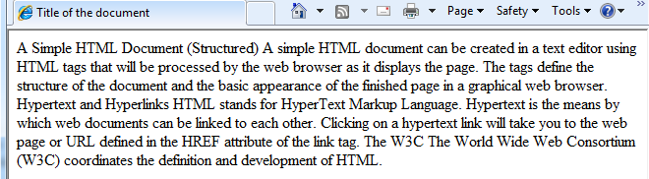
Example
15
Browser has ignored all the returns and therefore doesn’t
display text as paragraphs

Slide 16
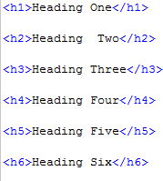
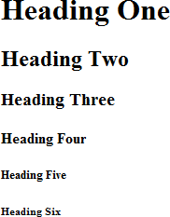
Headings
16
HTML headings are defined with the <h1> to <h6> tags
<h1> tag being the main heading
Each level being subheading of previous one

Slide 17
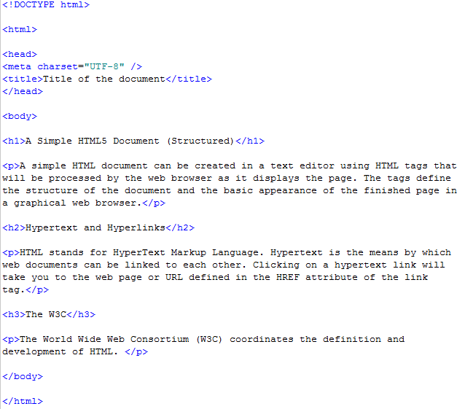
New Structure
17

Slide 18
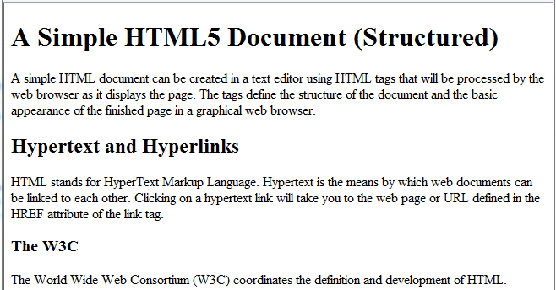
Example
18

Slide 19
Attributes
19
Provide additional information about HTML elements
Come in name/value pairs like name=“value”
Attributes are always specified in the start tag
Attributes either required or optional
<a href=“http://www.uws.ac.uk”> UWS</a>
href attribute required as it specifies URL of the page the
link goes to
<a href=“http://www.uws.ac.uk” target=“_blank”> UWS</a>
target is optional and specifies where to open the linked document

Slide 20
Links (Hyperlinks)
20
Defined using the anchor <a> tag
Word, group of words or image that you can click on to jump to a new document or a different location in the same document
External links
<a href=“http://www.w3schools.com”>W3 Schools</a>
Internal links
<a href=“index.html”>Home page</a>
Assumes index.html is in same directory as current file,
otherwise need to specify location
<a href=“www/index.html”>Home page</a>

Slide 21
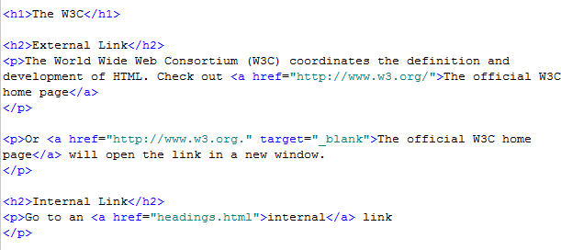
Example
21

Slide 22
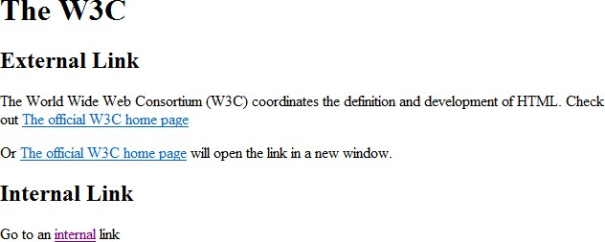
Example
22

Slide 23
Named anchors
23
Often used to create “table of contents” at the beginning of a large document
Each chapter within the document is given a named anchor
Links to each of these anchors are placed at the top of the document
Create a bookmark inside the same HTML document or inside another page
Create a link to it

Slide 24
Example
24
Create a bookmark
Create a link to it

Slide 25
Named anchors
25
Create a link to a bookmark in another document
Go to the bookmark named w3c in the HTML file called links2.html which is stored in the same directory

Slide 26
Types of Links
26
Absolute URL – points to another web site
href=“http://www.bbc.co.uk/news/contact.html
Relative URL – points to a file within a web site
Eg href=“default.html”
An anchor URL – points to an anchor within a page
Eg href=“#top”

Slide 27

Images
27
Defined with the <img> tag
Alt and src attributes are mandatory
Width attribute is optional
Good practice to keep images in separate folder

Slide 28

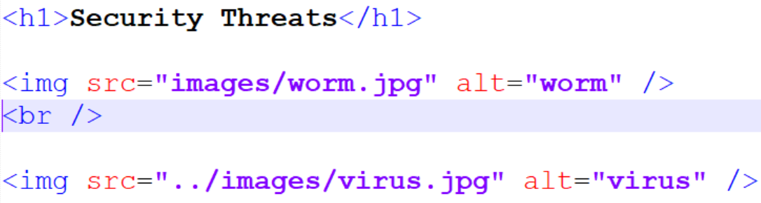
Example
28
Keep paths to images relative and NOT linked to local drives (Otherwise links will not work when uploaded)
Example 1 – images folder in same location as html file
Example 2 – images folder is one level up from html file

Slide 29
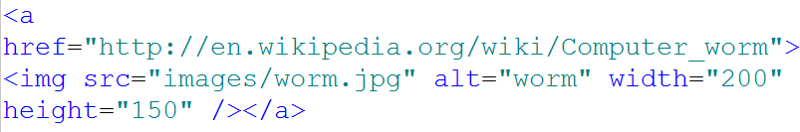

Image as a Link
29
An image can be defined within an anchor tag as a link
The image is displayed as a hyperlink
When clicked, it will display the page defined within the href attribute

Slide 30
Other tags
30
The <hr> tag creates a horizontal line
<hr /> should be used as it’s not a paired tag
The <p> tag automatically adds an empty line before and after a paragraph
The <br> tag creates a line break and moves to the next line
<br /> should also be used

Slide 31
Lines/Comments
31
Comments can be added which are not displayed in the browser
Good practice to use them
May be displayed in different colour
Format is:
<!-- Comment to be added -->

Slide 32
Display source code
32
HTML Code can be displayed in browsers
Useful if you see a web site and wonder how it has been created
Variations between browsers
Mozilla Firefox
Tools menu, Web Developer, Page Source
Alternatively, Ctrl+U
Microsoft Internet Explorer
View menu, Source
Another window will be displayed the HTML code

Slide 33
Character Entities
33
Some characters are reserved in HTML.
Eg It is not possible to use the less than (<) or greater than (>) sign in your text as the browser will mix them up with tags.
Reserved characters in HTML must be replaced with character
entities.
This can be done either by using an entity name or a number.
Less than symbol (<):
&entity name;
&entity number;
&lt; &#60;
Entity names are easier to remember but browsers may not support all entity names. Whereas the support for entity numbers is very good.

Slide 34
Useful Character Entities
34
Result | Description | Entity Name | Entity Number
 | non-breaking space | &nbsp; | &#160;
< | less than | &lt; | &#60;
> | greater than | &gt; | &#62;
& | ampersand | &amp; | &#38;
¢ | cent | &cent; | &#162;
£ | pound | &pound; | &#163;
¥ | yen | &yen; | &#165;
€ | euro | &euro; | &#8364;
§ | section | &sect; | &#167;
© | copyright | &copy; | &#169;
® | registered trademark | &reg; | &#174;
™ | trademark | &trade; | &#8482;
http://www.w3.org/TR/html4/sgml/entities.html

Slide 35
HTML Style Attribute
35
Syntax: <tagname style=“property:value;”>
The property is a CSS property.
More on CSS in other weeks.

Slide 36
Examples
36
Background colour:
<body style="background-color:powderblue;">
Text colour:
<h1 style="color:blue;">This is a heading</h1>
<p style="color:red;">This is a paragraph.</p>
Fonts:
<h1 style="font-family:verdana;">This is a heading</h1>
<p style="font-family:courier;">This is a paragraph.</p>

Slide 37
Examples
37
Text Size:
<h1 style="font-size:300%;">This is a heading</h1>
<p style="font-size:160%;">This is a paragraph.</p>
Text Alignment
<h1 style="text-align:center;">Centered Heading</h1>
<p style="text-align:center;">Centered paragraph.</p>

Slide 38
Lists
38
The most common HTML lists are ordered lists and unordered lists
Similar to numbers/bullets features in other applications
Defined using the ordered list <ol> and unordered list <ul> tags
Each list item uses the list <li> tag
There is also a definition list which is a list of items, with a description of each item
Defined using different tags:
definition list <dl> tag
definition term <dt> tag
definition description <dd> tag

Slide 39
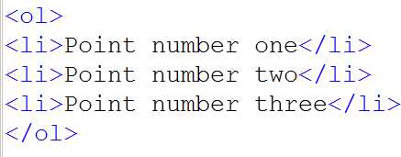
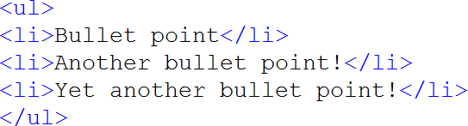


Examples
39
Ordered list
Unordered list
Output in browser
Output in browser

Slide 40
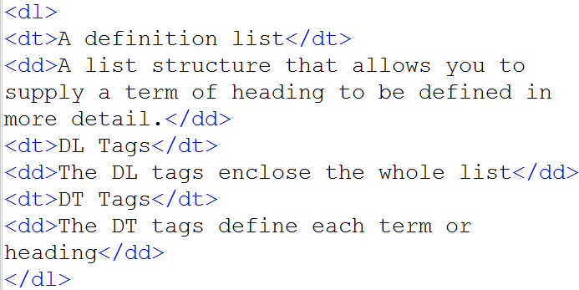
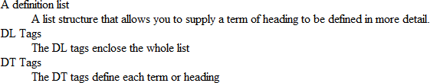
Definition List
40
Output in Browser

Slide 41
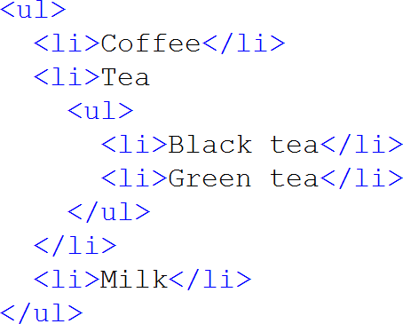

Nested Lists
41
A list within another list - Example

Slide 42
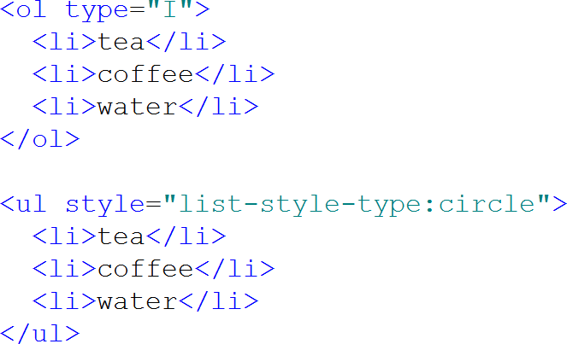

List - Attributes
42
Ordered lists
Type attribute
Value: 1, A, a, I, I
Unordered lists
Style attribute
Value: list-style-type:XX where XX can be circle, square, disc or
none

Slide 43
w3schools
43
www.w3schools.com
Familiarise yourself with the web site
Notice level of browser support for HTML tags
Look at differences between HTML and HTML5
Try out some examples and quizzes
Check out tag references and bookmark/print one for
handy reference

Slide 44
Lab
44
The Lab sheet is on Moodle
There is also a zipped ‘Sample files’ on Moodle which you should download before starting the Lab sheet
Look at the ‘Sample files ‘ folder with sub folders for:
Video
Audio
Images
These folders contain sample files which you can use for some of the labs. Otherwise you can source your own files as long as you consider copyright regulations.

